Slide 1
CUSTOMER BEHAVIOR ANALYSIS REPORT
By Qadir Bux

Slide 2
INTRODUCTION
I did Customer Behaviour analysis on an Dataset Named Marketing Data in which I analyzed the data by importing , cleaning, and did EDA, Created an Dashboard and gave insights and recommendations

Slide 3
OBJECTIVES
Customers demographics and geographics
To find the relationship of variables with eachother.
To increase sales
To Find out target audience
To fi

Slide 4
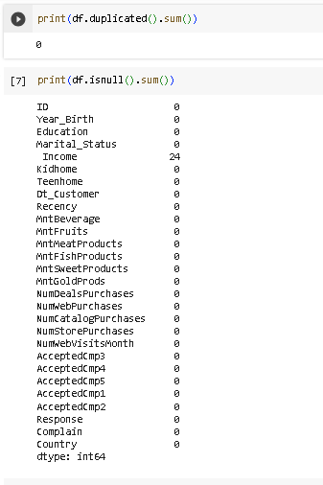
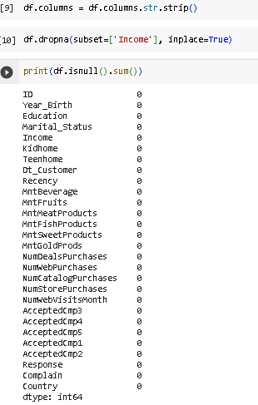
DATA CLEANING
I cleaned the data by identifying and handling duplicates and null values

Slide 5
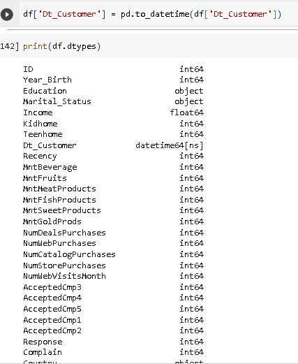
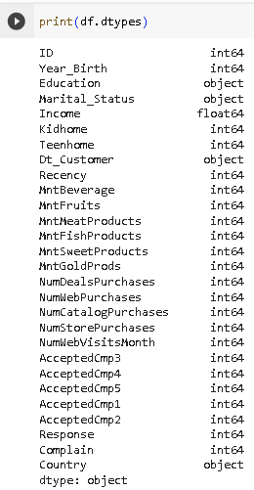
Data Types
I changed Data type of Dt_customer from object to Datetime

Slide 6
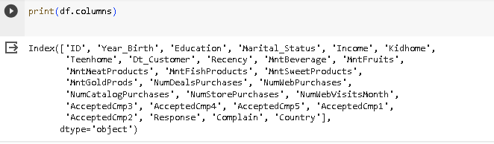
COLUMN NAMES
These are all the column names

Slide 7
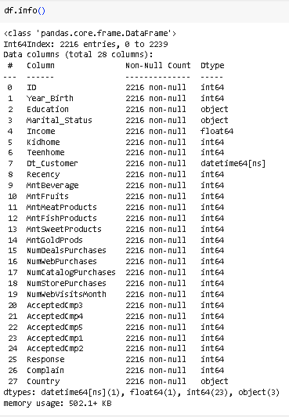
Information Regarding Dataset
In the dataset there were 2216 rows and 27 Columns initially

Slide 8
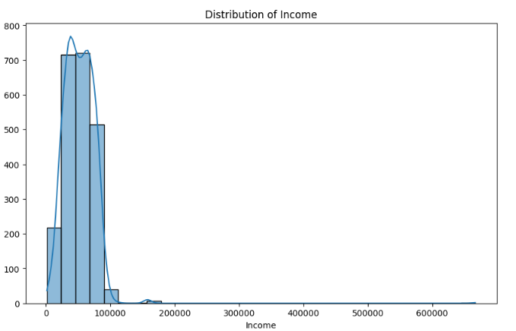
Distribuiton of Income
Here we can see the distribuiton of income among the customers where most of our customer has around 40K to 60K income while few have around 200 customer have 20K income while around 500 have 80K income while around 20 have 100K income

Slide 9
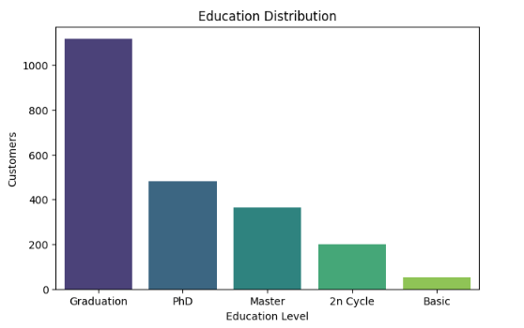
Education Distribuition
There were over 1000 customers which were graduated, over 400 were PHD holders, Almost 400 had Masters , Just 200 were 2n Cycle while around 50 had basic level of education as most of the customer have decent amount of education

Slide 10
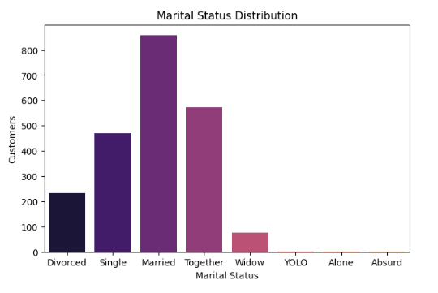
Marital Status Distribuiton
Most of our customers are Married followed by Together,Single, Divorced, Widow, YOLO,Alone and Absurd

Slide 11
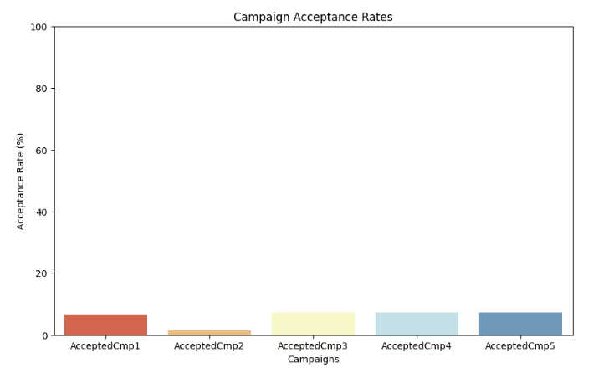
Campaign Acceptance Rates
As the result showed that Marketing Campaigns weren’t successful as all of the campaigns have low Acceptance Rates

Slide 12
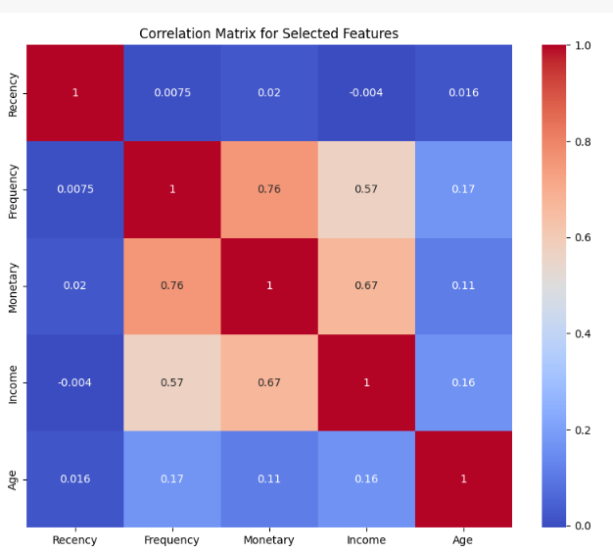
Age has weak positive relationship with frequency, Monetary and income while age has almost no relationship with recency
Income has no relationship with recency while it has moderate positive relationship with monetary and frequency
Monetary and Recency have almost no relation ship while Monetary and Frequency have strong positive relationship
Recency and Frequency have almost no Relationship

Slide 13
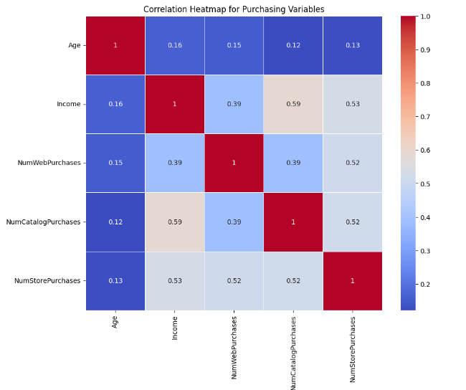
Age has weak positive relationship with all the purchases types
Income has strong positive relationship with all the types of purchases
All the purchases have positive strong relationship with eachother

Slide 14
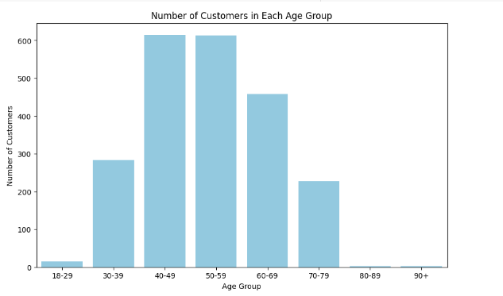
Number of Customers in Age Groups
There were around 1200 Customers From age 40 to 60 , around 450 in 60-69 age group , just below 300 customers in 30-39 , just over 200 customers in 70-79 ag group while it had few in 18-29 and almost 1 or 2 in 80-89, 90+

Slide 15
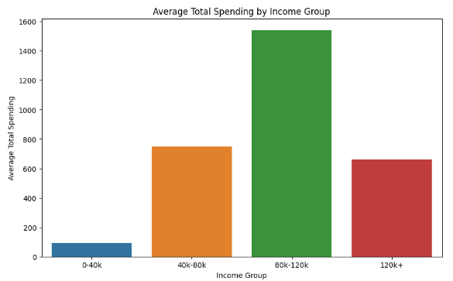
Average Total Spending by Income Group
Here we can see that as the income increases the spending increases except of 120k income group

Slide 16
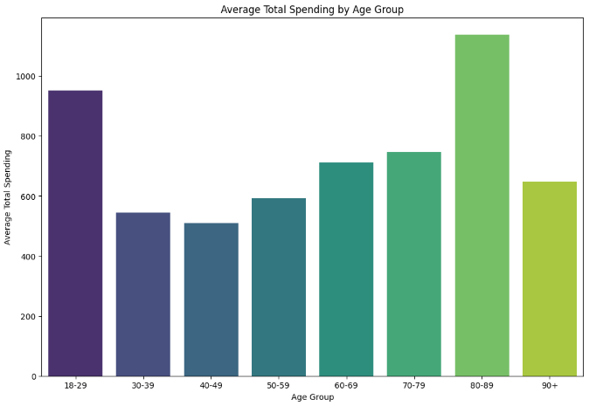
AVG TOTAL SPENDING BY AGE GROUP
AVG Total spending of age group 80-89 is the highest followed by 18-29,70-79,60-69,90+,60-69,30-39,40-49

Slide 17
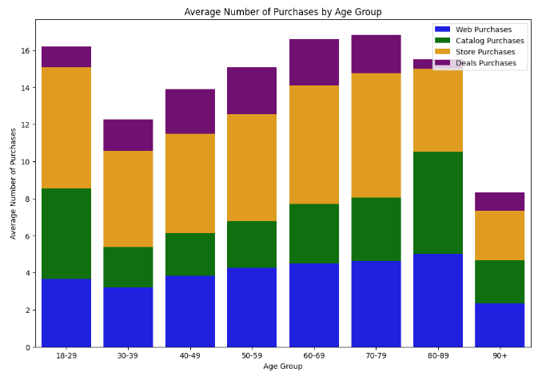
AVG NUMBER OF PURCHASES BY AGE GROUP
Age Group 70-79 Has the highest average purchase followed by 60-69, 18-29, 80-89,50-59, 40-49, 30-39 and 90+

Slide 18
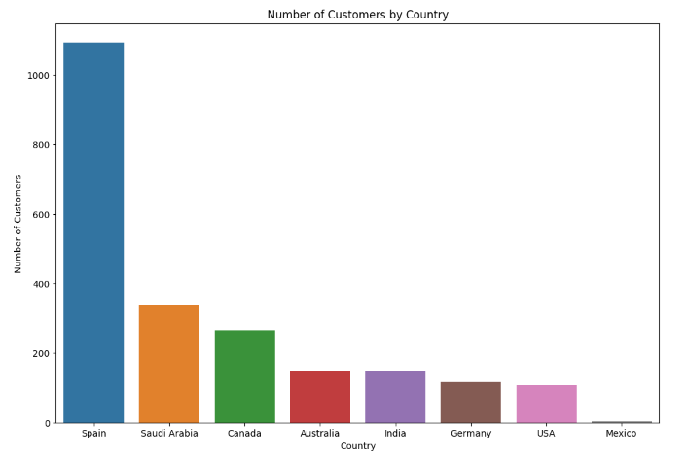
NUMBER OF CUSTOMERS BY COUNTRY
Spain has the most number of customers with around 1100 Customers, Followed by Saudi Arabia around 300 , Canada around 250 , Australia and India almost 150, Germany Just over 100, USA almost 100 and Mexico around 5

Slide 19
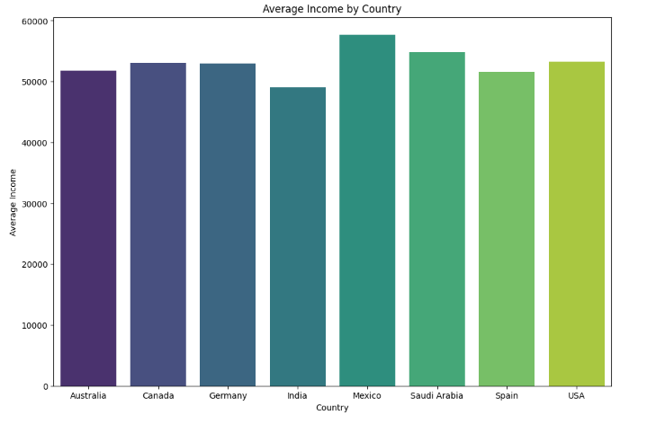
AVG INCOME BY COUNTRY
The Avg income of each country is almost same with slight difference with Mexico on the top followed by Saudi a Arabia, Canada, Germany, USA, Australia, Spain and India

Slide 20
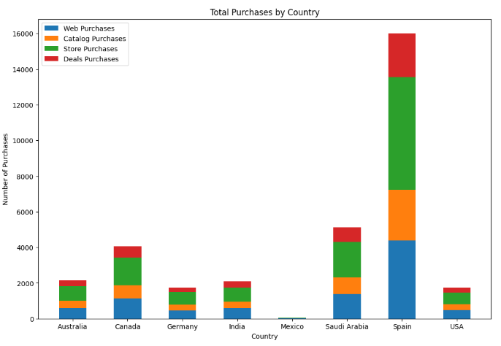
TOTAL PURCHASES BY COUNTRY
Spain has the highest total number of purchases followed by Saudi Arabia, Canada, Australia, India, USA, Germany and Mexico

Slide 21
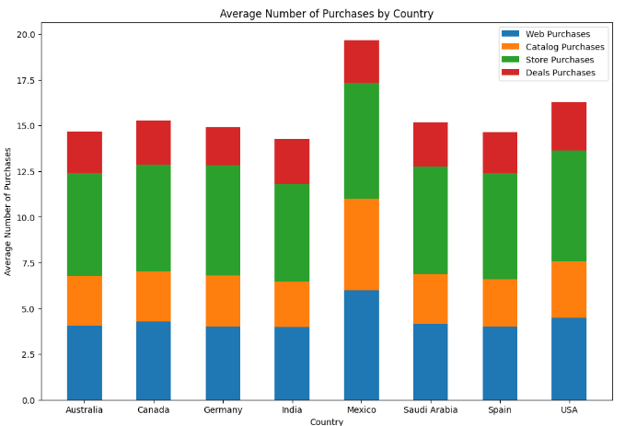
AVG NUMBER OF PURCHASES BY COUNTRY
Overall the avg number of store purchases is higher in every country followed by Web purchases, Catalogue Purchases and Deals Purchases

Slide 22
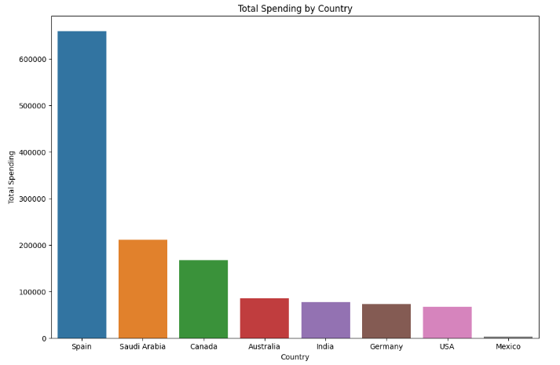
TOTAL SPENDING BY COUNTRY
Spain has the highest total spending followed by Saudi Arabia, Canada, Australia, India, Germany, USA and Mexico

Slide 23
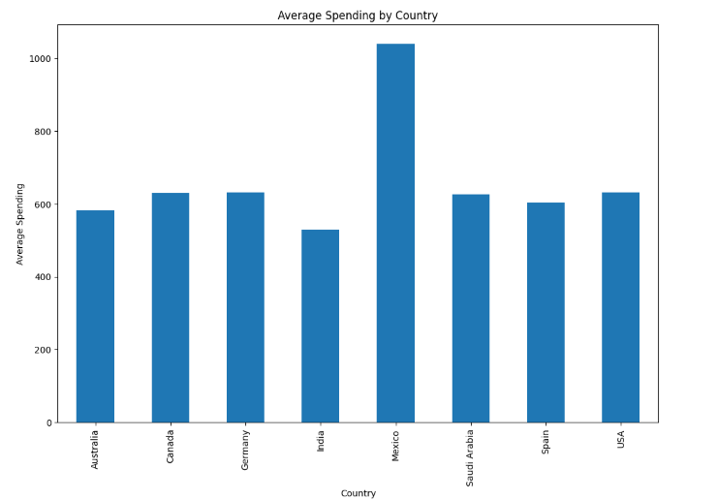
AVG SPENDING BY COUNTRY
Mexico has the highest average spending followed by Germany, Canada, USA, Saudi Arabia, Australia, Spain and India

Slide 24
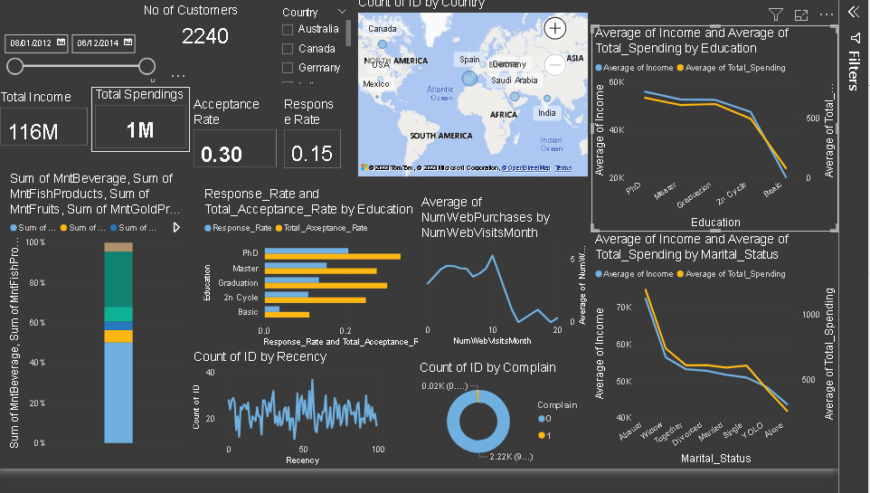
DASHBOARD

Slide 25
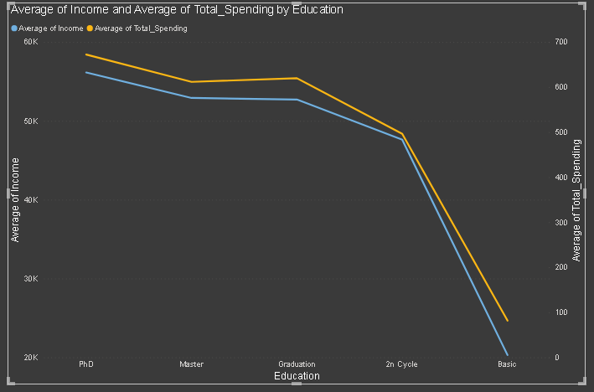
AVFG INCOME AND AVG TOTAL SPENDING BY EDUCATION
The higher income the higher spending
The higher level of Education The higher Income

Slide 26
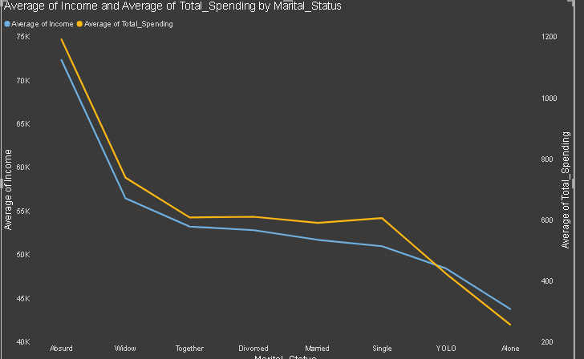
AVFG INCOME AND AVG TOTAL SPENDING BY Marital Status
Similarly the higher income the higher spending

Slide 27
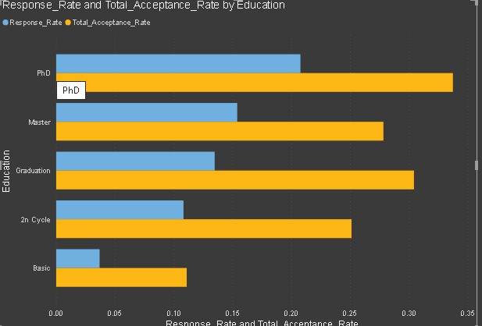
RESPONSE RATE AND TOTAL ACCEPTANCE RATE BY EDUCATION
The higher Education the better response rate and acceptance rate

Slide 28
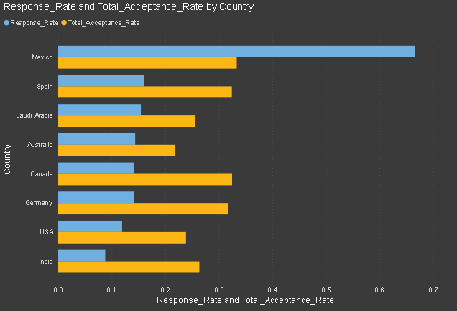
RESPONSE RATE AND ACCEPTANCE RATE BY MEXICO
Mexico has the highest response and acceptance rate
While Australia has the lowest acceptance rate
And india has the lowest response rate

Slide 29
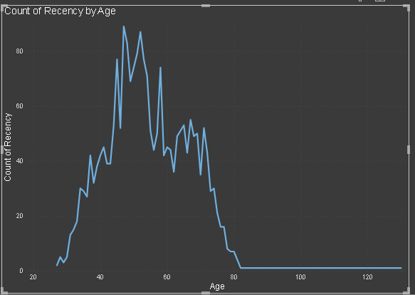
RECENCY BY AGE
We can say as the age increases the recency increases till some point

Slide 30
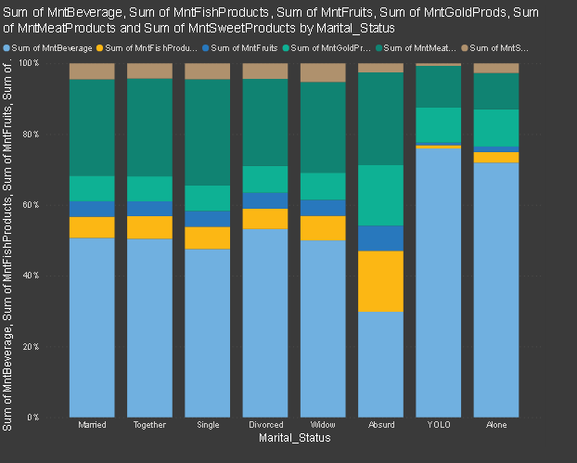
SUM OF ALL CATEGORIES BY MARITAL STATUS
Overall the sum of beverage is higher than others in every marital status followed by meat.

Slide 31
Insights
Most of the customers income ranges between 20k to 100k
Most of the Customers educational background is Graduation followed by PHD, Masters.
Most of the customers marital status is Married followed by Together, Divorced and single
All the recent market campaign were accepted below 10%
Monetary and Frequency have strong relationship
Income has good positive relation ship with Monetary and Frequency.
Income have strong relationship with all the purchases types
All the purchases have strong relationship with eachother
Most of the customers were aged 40 to 59 followed by 60 to 69 , 70 to 79 and 18-29
The aged-group who had lower customer had high spending average and purchases average

Slide 32
INSIGHTS (CONT)
Spain had the most number of customers while mexico had the lowest
Mexico had the average income while the rest of the countries had similar and india had the lowest
Spain had the highest total purchases followed by Saudi arabia, Cananda, Australia , USA, India and Mexico
Store Purchases were the highest followed by Web Purchases, Catalog Purchases and Deals Purchases
Mexico had the highest average purchases
PHD holders had the highest average income and average spending followed by Masters, Graduation, 2nd Cycle and Basic
PHD holders had the highest acceptance rate and response rate while australia had the lowest total acceptance rate and india had the lowest total response rate
Overall the beverage had generated the highest amount but YOLO and Alone had way much higher beverage while Meat products and gold products were second and third most sold followed by fishproducts while fish products had the most sales in Absurd type of Marital status.
Only 21 customers had complained
The average purchases increased as the number of visited increased till some point

Slide 33
RECOMMENDATIONS
We need to target customers income ranged from 20k to 100k , graduated and married as the are the majority of our customers.
We need improve our marketing campaigns are effective by setting our target audience
Also we need to cater customers of high income as they tend to purchase and spend more
We need to understand customers channel preferences and attract them to use one of them.
Retain customers from aged 40 to 59 and attract other age group with fewer customers but have higher average spending and purchases
Attract more customers from countries which have lower customer as they have high average spending and purchases
Make all the channels effective as they tend to bring more purchases
Target customers of high level of education as they have spend more
Personalized marketing based on the marital status will be beneficial

